Slide 1
Factory IO – Quick start
M2C3 – Basic PLC Programming

Slide 2











Content
2
Introduction into Real Games Factory IO
Introduction
First steps
Simulate scenarios
Design scenarios
Excersise

Slide 3
Disclaimer
3
Introduction into Real Games Factory IO
"The European Commission's support for the production of this publication does not constitute an endorsement of the contents, which reflect the views only of the authors, and the Commission cannot be held responsible for any use which may be made of the information contained therein."

Slide 4
Introduction
4
Introduction into Real Games Factory IO
Factory IO from Real Games is a 3D factory simulation environment where you can turn a computer into a PLC¹ training kit.
It works with any PLC with no risk of injury to students or damage to equipment. It brings small to large-scale industrial applications to the classroom.
It allows to practice real factory automation control tasks inspired by common industrial applications.
¹ PLC = Programmable Logic Controller = Machine controller

Slide 5
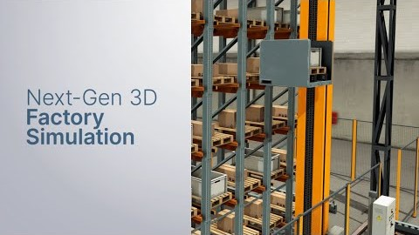
Introduction
5
Introduction into Real Games Factory IO

Slide 6
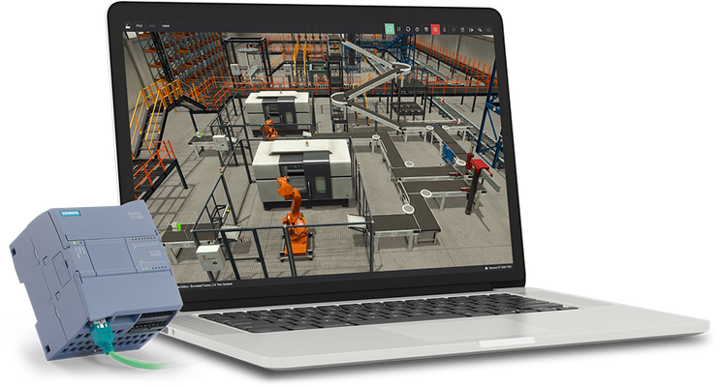
Introduction
6
Introduction into Real Games Factory IO
Factory IO is meant to use in combination with a machine controller.
The machine controller, usually a PLC, contains the software program for operation of the machine in automatic, semi-automatic or manual mode.
Factory IO is compatible with most machine controllers via an Ethernet connection.

Slide 7
Introduction
7
Introduction into Real Games Factory IO
Factory IO is available in 7 different editions and each edition includes IO drivers targeting specific technologies.
https://factoryio.com/editions
The Siemens edition has been selected for the ACTEA-project where it is compatible with Siemens LOGO!, S7-200, S7-300, S7-400, S7-1200, S7-1500, S7-PLCSIM and S7-PLCSIM Advanced controllers provided they have an Ethernet connection.

Slide 8
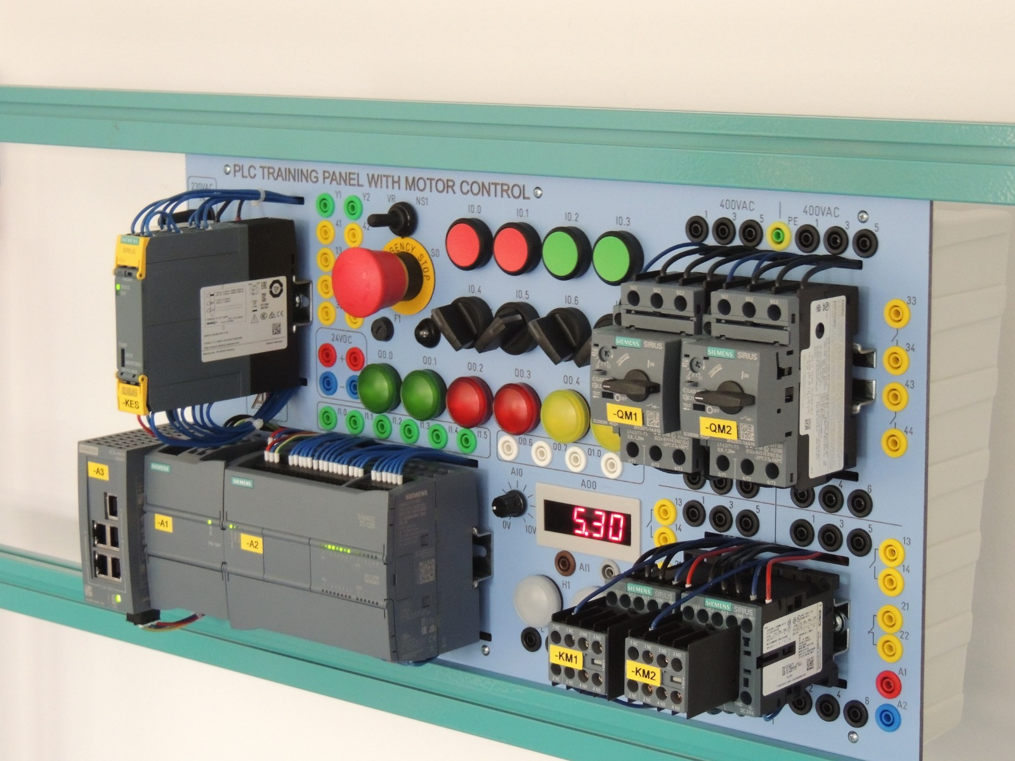
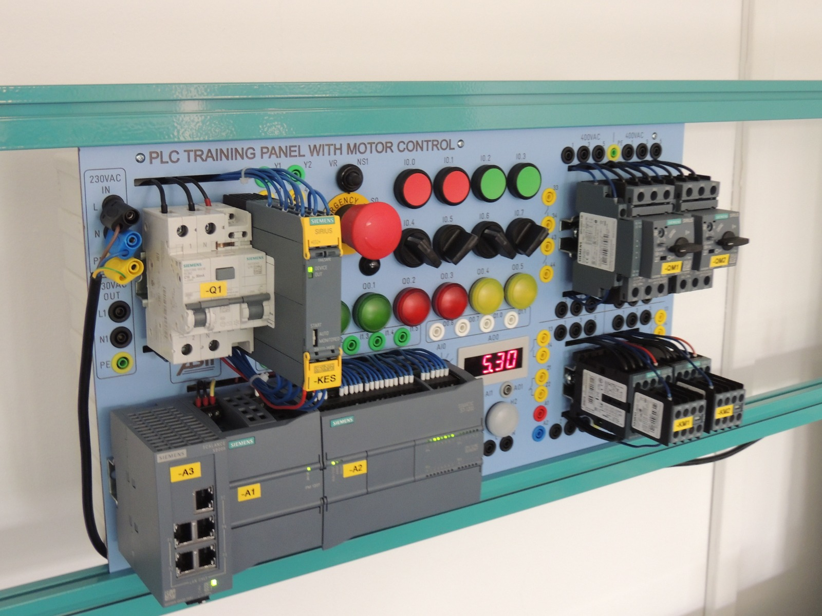
Introduction
8
Introduction into Real Games Factory IO
The Siemens edition has been selected because the ACTEA PLC-boards for the courses M2C3 Basic PLC Programming & M2C4 Advanced PLC Programming comes with Siemens S7-1200 CPU’s.

Slide 9

First steps
9
Introduction into Real Games Factory IO
The program can be downloaded from the Factory IO website by downloading (click here) a free trail version.
The free trail version is the full-featured Ultimate edition and you need to register yourself before the download.
The Factory IO icon will be showed on your desktop after the installation process. The current version is version 2.4.5.

Slide 10
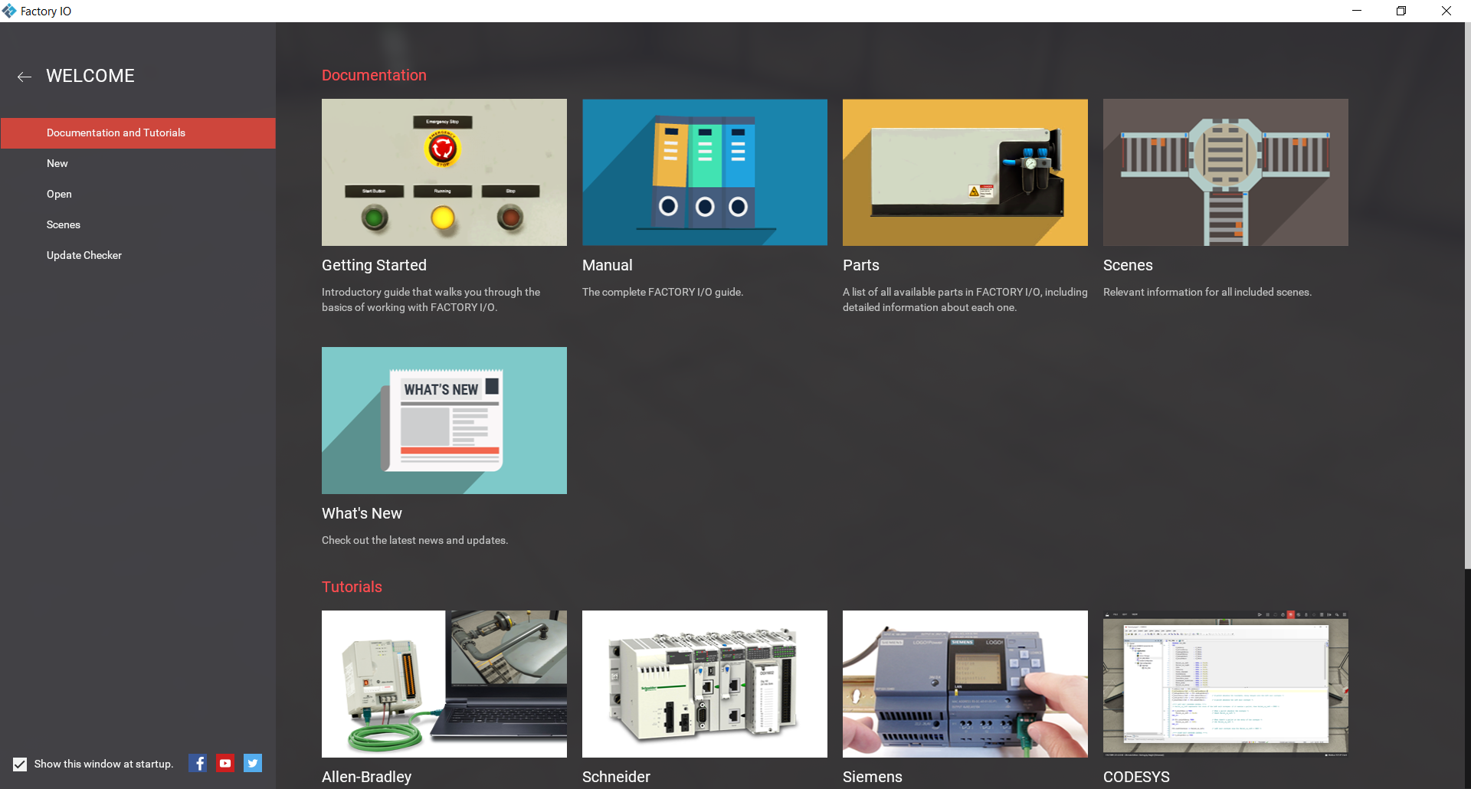
First steps
10
Introduction into Real Games Factory IO
The welcome screen is showed after the startup.
Here you can open manuals & tutorials, check for new updates and you can open and saves Factory IO files called “Scenes”.
Notice that an internet connection is required because some parts, such as the manuals, are online manuals.

Slide 11
First steps
11
Introduction into Real Games Factory IO
1. Click on Getting started!
2. Read the next chapters:
Overview
Navigating
Open a scene
3. Start Factory IO
4. Open one of the scenes
5. Test you navigating skills

Slide 12

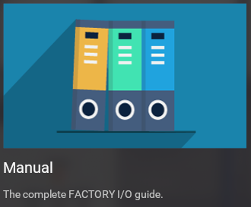
First steps
12
Introduction into Real Games Factory IO
Mmm… navigation is not so easy! Maybe camera navigation can help?
Go back to the welcome screen with the home button
Open the complete Factory IO guide
Read the next chapters
User Interface
Navigation
Open a new scene
Test your new skills by using
The “Cameras window”
The “Camera Tizmo”

Slide 13
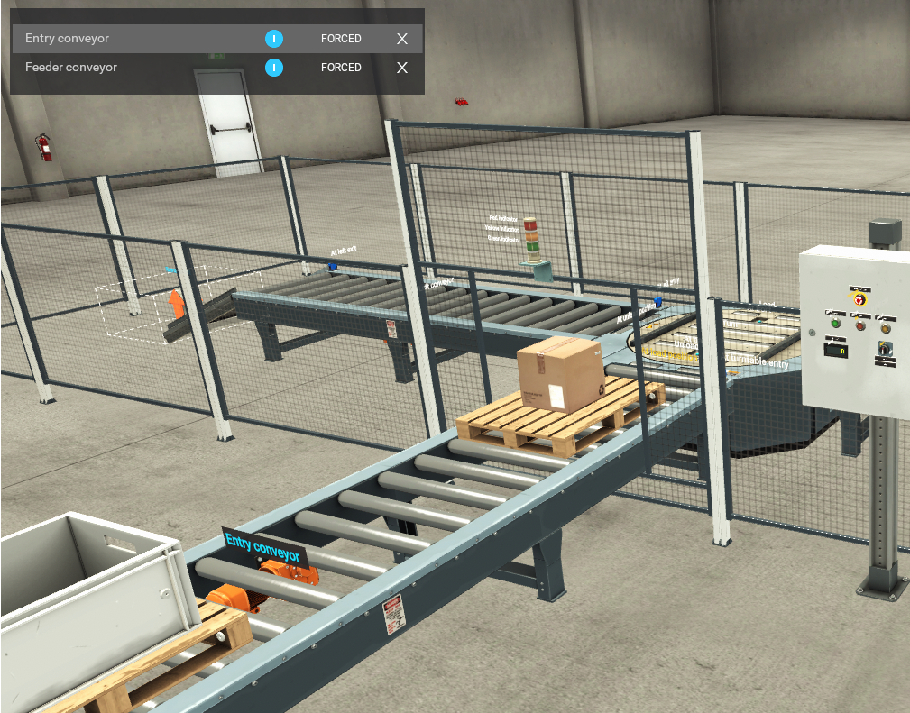
Simulate scenarios
13
Introduction into Real Games Factory IO
Let's get some action!
Open the Getting started guide
Read the next chapter
Manually controlling a scene
Open the scene
Sorting by height (Advanced)
Test your new skills by manually transporting pallets to the exits
Move the pallets to the turntable by activating the motors
Sort 5 pallets to the left
Sort 5 pallets to the right

Slide 14
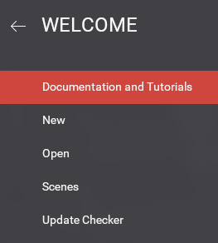
Simulate scenarios
14
Introduction into Real Games Factory IO
Tags? What is this?
Open complete Factory IO guide
Read the next chapters
Tags
Failure injection
Go back to the scene by using the arrow left (beside Welcome)
Sorting by height (Advanced)
Test your new skills and
Try to create a wire break on the At front sensor of the turntable
Compare the status of this sensor with the At back sensor

Slide 15
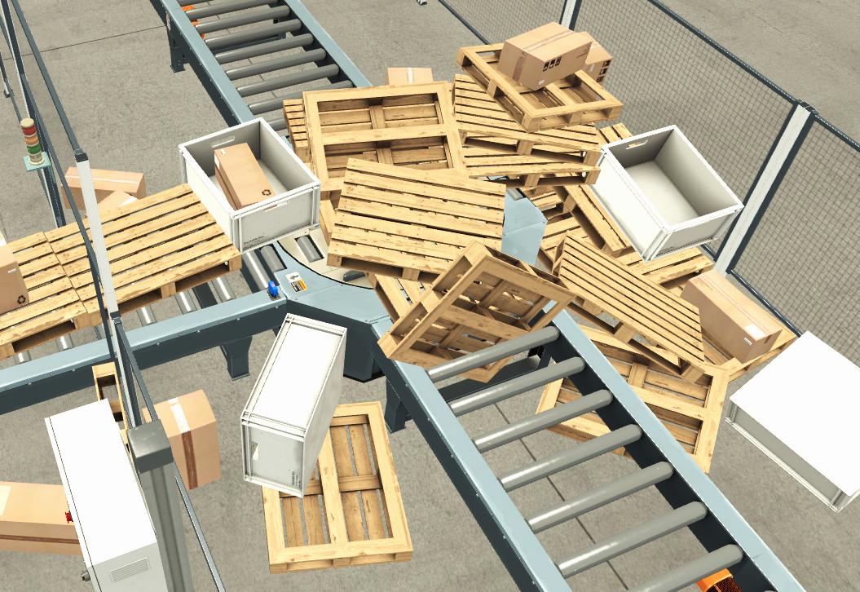
Simulate scenarios
15
Introduction into Real Games Factory IO
Wow! This factory is to fast for me!
Open complete Factory IO guide
Read the next chapter
Edit and Run (the Run part)
Go back to the scene
Sorting by height (Advanced)
Test your new skills and
Do this in slow motion and by pause the scene
Create a huuugh jam! Yes, let’s create problems by
Running pallets of the turntable
Placing pallets wrong onto the conveyors by grabbing pallets, totes and boxes
Reset the simulation

Slide 16
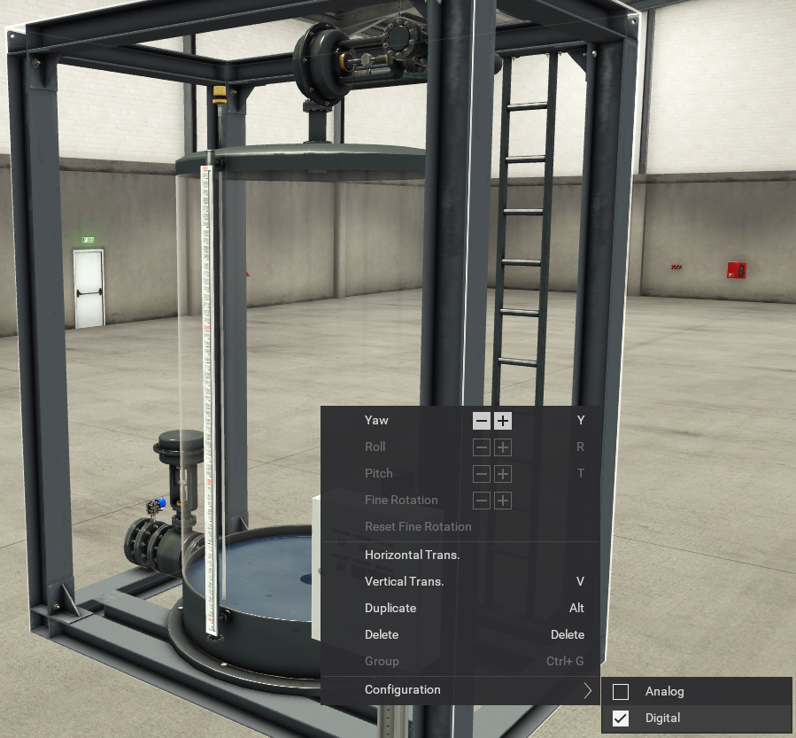
Simulate scenarios
16
Introduction into Real Games Factory IO
Let’s cool down and create some water.
Open complete Factory IO guide
Read the next chapter
Edit and Run (the Edit part)
Parts > Stations > Tank (use the table of contents at the right)
Open the scene
Level control
Test your new skills and
Test the water tank by filling it. Don’ forget to check the sensors
Empty the tank
Edit the water tank by changing it to a digital configuration
Repeat the test

Slide 17
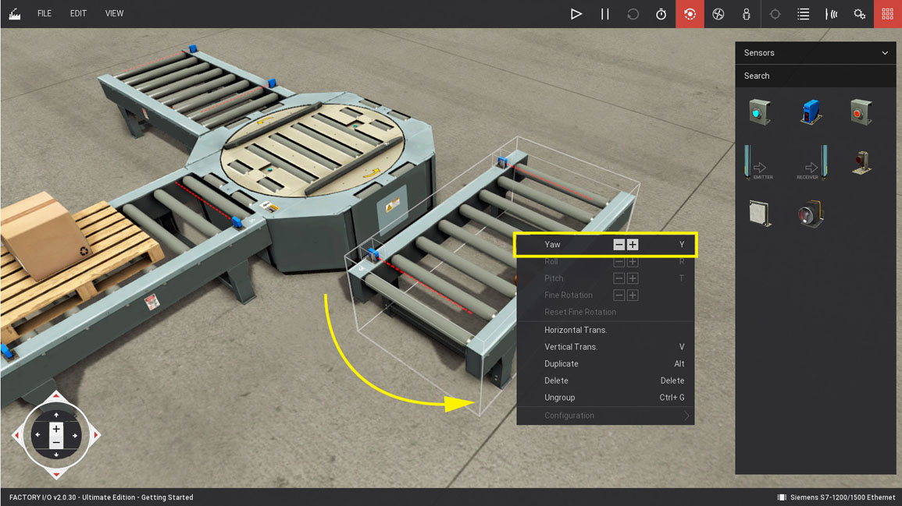
Design scenarios
17
Introduction into Real Games Factory IO
So I can create my own scenarios?!
Open the Getting started guide
Read the next chapter
Create a scene
Create a new scene and call it
Sorting my goods
Create and test your scene
As described in “Create a scene”
Add an emitter at the entry
Add a remover at each exit
Test your scene

Slide 18
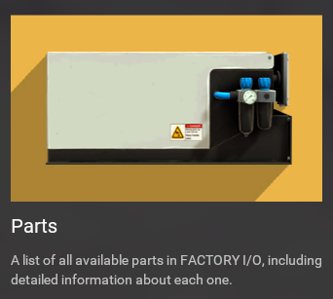
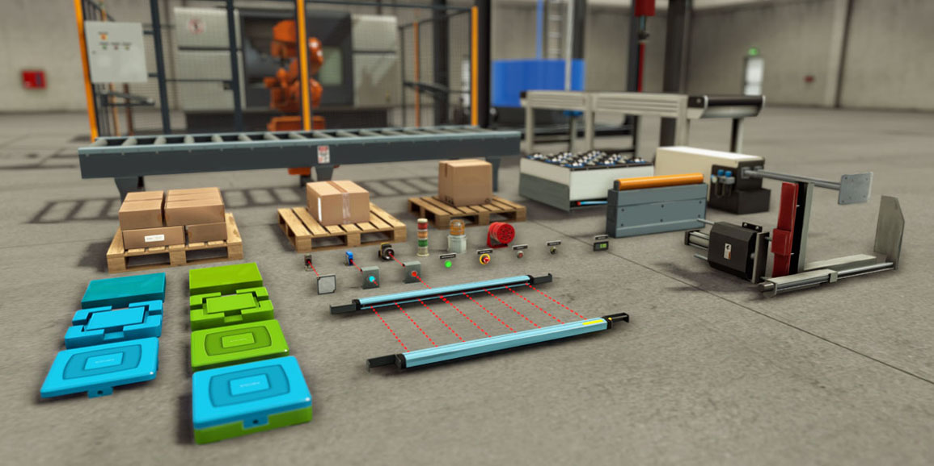
Design scenarios
18
Introduction into Real Games Factory IO
Can I change the items on the pallets?
Go back to the welcome screen
Open the Parts manual
Read the next chapters
Emitter
Remover
Items
Go back to your scene and
Change the part to emit
Change the time pallets appear
Test your scene
Repeat this where you modify the base

Slide 19
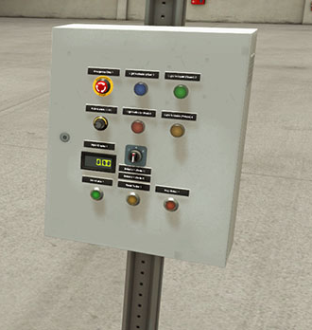
Design scenarios
19
Introduction into Real Games Factory IO
There is no control cabinet!
Go back to the welcome screen
Open the Parts manual
Read the next chapters
Operators
Warning devices
Go back to your scene and
Create the control cabinet as showed on the picture
Add a warning devices to the control cabinet
Make a group of the cabinet
Don’t forget to mount the control cabinet on a column
Test your scene

Slide 20
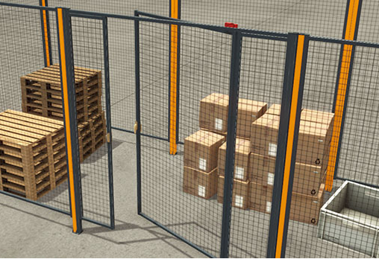
Design scenarios
20
Introduction into Real Games Factory IO
Safety first!
Go back to the welcome screen
Open the Parts manual
Read the next chapters
Walkways
Go back to your scene and
Add some safeguards and a safety door
Test your scene (don’t forget to test the door)
Save your scene

Slide 21
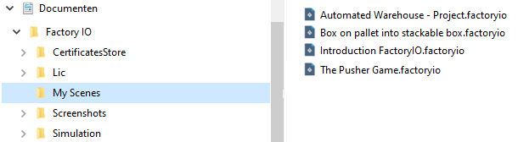
Design scenarios
21
Introduction into Real Games Factory IO
Where to find the saved files?
Open Windows Explorer
Go to My Documents and open the Factory IO directory
Open the My Scenes directory
Factory IO files have the extension .factoryio
Task
Find your scene
Copy it to your desktop

Slide 22
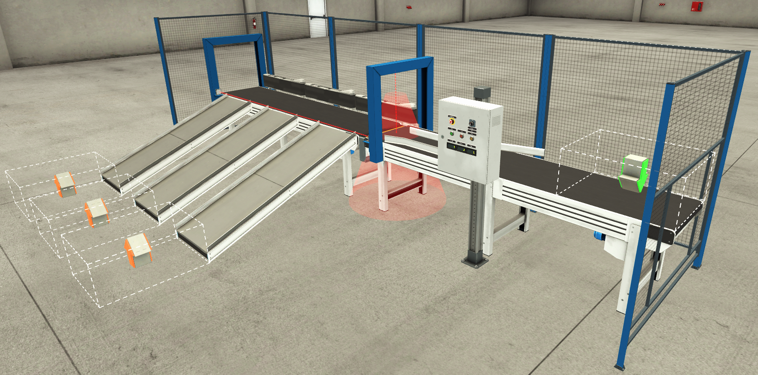

Exercise
22
Introduction into Real Games Factory IO
Create the “Sorting station” scene on your own
Create a new scene called “My sorting station”
View the scene video in the scene manual
You can cheat by viewing the scene from Factory IO

Slide 23
Exercise
23
Introduction into Real Games Factory IO
Test the “My sorting station” scene
Try to sort the boxes
Change the configuration of the belts to analog
Test your changes

Slide 24


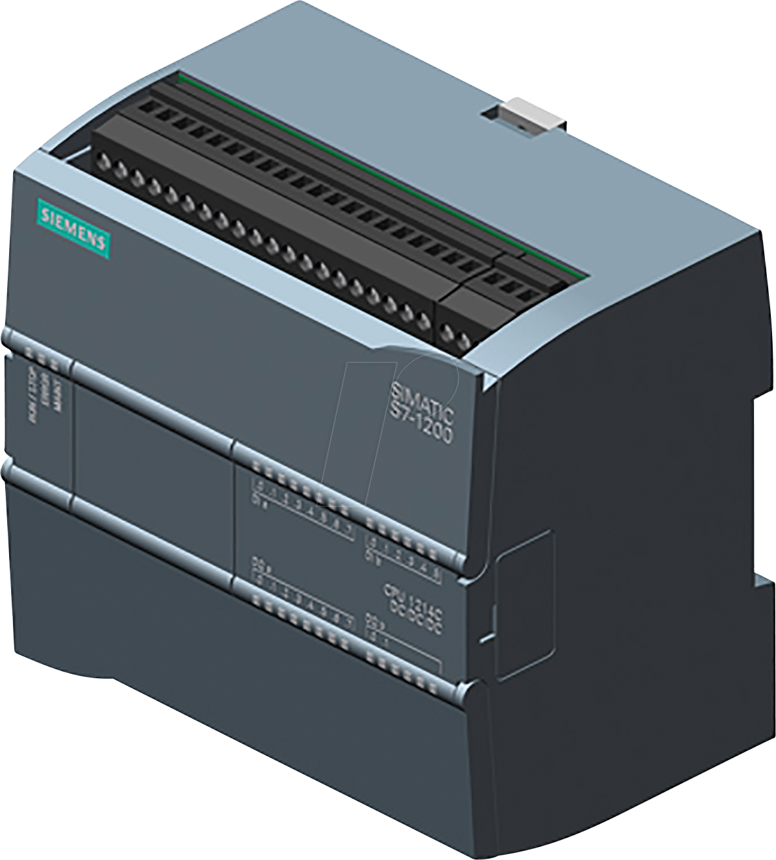
To resume
24
Introduction into Real Games Factory IO
Congratulations! You have reached the level “Newby in Real Games Factory IO”
You can open, save and navigate in Factory IO scenes
You can design Factory IO scenes
You can simulate Factory IO scenes
Real Games Factory IO
Siemens TIA Portal
Done in this training
Not in this training

Slide 25
Contact
25
Introduction into Real Games Factory IO
AP University college
Geert Van Grieken
Email: geert.vangrieken@ap.be
Address : Ellermanstraat 33, B-2060 Antwerp, Belgium

